Slide 1
Comparing several parallel programming languages: OpenMP and MPI
Yantao Luo, Yuchen Zhao
05.03.23

Slide 2
Problem Definition
01
Runtime overhead
Time to create and destroy the worker
Execution time of same problem
Different problem size
02
Scalability
Fixed problem size with different number of workers
Fixed number of workers with different problem size
03
Programmability
Extra lines of directives and functions
Memory management
Steps to implement same parallel benchmark
04
The amount of control
Can the programmer choose hardware cores
Can the programmer decide private and public variable
Notes:
Since the end of Moore’s law is in sight, parallel computing has become an essential technique to achieve high-performance computing for large-scale scientific and engineering applications. Two dominant parallel models are OpenMP, which stands for Open Multi-Processing, and MPI, which stands for Message Passing Interface. These models can help programmers divide a task into smaller pieces and utilize multi processors for better performance. Both models are widely used in modern high performance computing.
In this project, we compared these two parallel programming language models from four perspectives: Runtime overhead, scalability, programmability and the amount of control given to the programmers

Slide 3
Literature Survey
J. Diaz, etc: A Survey of Parallel Programming Models and Tools in the Multi and Many-Core Era
Compared OpenMP and MPI from the mechanism.
Reasons to combine OpenMP and MPI.
S. J. Kang, etc: Performance comparison of openmp, mpi, and mapreduce in practical problems
Designed a set of benchmark programs that can be used to evaluate and compare the performance and scalability of OpenMp and MPI.
Lorin Hochstein, etc: A preliminary empirical study to compare MPI and OpenMP
Did an experiment to evaluate the programmability of two models.
Bova, S.W., etc: Parallel programming with message passing and directives
Comprehensive comparison of DMP and SMP
Implemented both languages on several types of applications
Notes:
Before we proceed to the experiment part, let’s take a look at literature survey we’ve done.
The first paper compared OpenMP and MPI from the mechanism perspective. They pointed out OpenMP is a language model with fine granularity and implicit synchronization, while MPI is a more coarse-grained message passing model.
The second one designed a set of benchmark programs including Floyd-Warshall algorithm and join problem.
The third one did a very interesting experiment. They asked a group of programmers to solve sharks and fishes problem using OpenMP and MPI. As a result, OpenMP development time was 9.6 hours less than MPI in average.
The last one did a comprehensive comparison of DMP, which stands for distributed memory programming and SMP, which stands for shared memory programming.

Slide 4
Experiment Setup
Worker creation and destruction
Reduction
Matrices multiplication
For MPI, we use MPI_Scatter to distribute the task to each process and MPI_Reduce to collect local sum. For OpenMP, we use omp parallel for reduction directive.
Try different worker numbers and different problem size. Record the time of reduction part of each program to compare the scalability. Compare the code structure to analyse the programmability.
For MPI, we create processes at the beginning. For OpenMP, we write a for loop to repeatedly create and destroy threads.
Try different worker numbers and record the time of the whole program to compare the overhead of worker creation and destruction.
For MPI, we use MPI_BCast to broadcast matrices to each processes and use MPI_scatter and MPI_gather to distribute the task and collect the result. For OpenMP, we use parallel for directive to complete the job.
Try different worker numbers and different problem size. Record the time of multiplication part to compare the scalability. Compare the code structure to analyse the programmability.
Notes:
In our project, we designed three benchmark programs to compare characteristics of OpenMP and MPI.

Slide 5
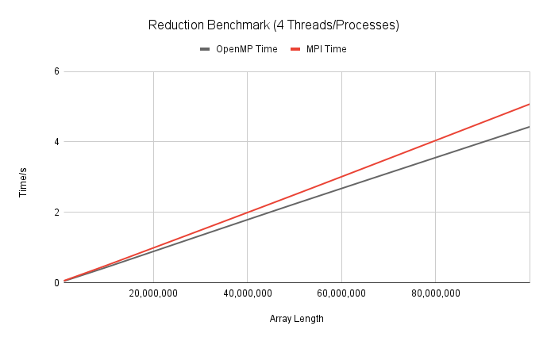
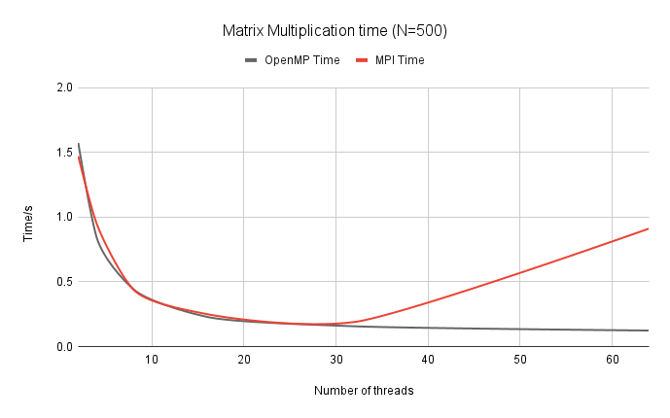
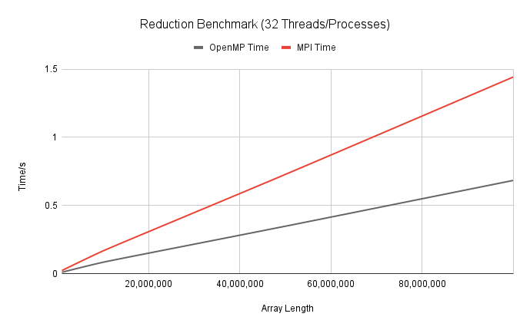
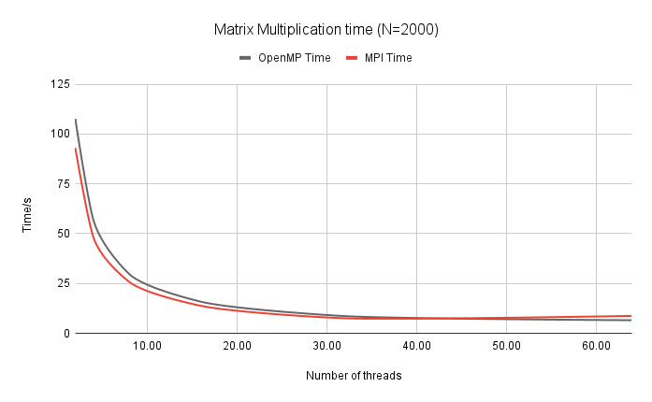
Result and Analysis

Slide 6
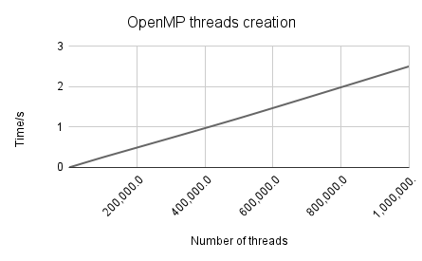
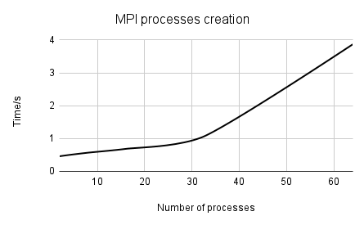
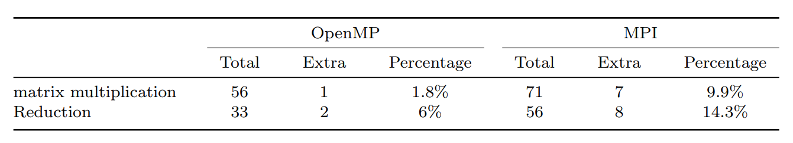
Result and Analysis

Slide 7
Conclusion
The overhead of creating a MPI process is 34,000 times greater than that of creating a omp thread.
Creating a process takes much more time than creating a thread. For OpenMP, this overhead is linear to the number of threads created. However, for MPI, The overhead gets greater as the number of processes increases.
OpenMP outperformed MPI when the problem size is small
The implicit synchronization mechanism and strong parallel runtime implementation of OpenMP make it more suitable for problems that can be solved using a single shared memory system.
Combining OpenMP and MPI properly in a single program can very likely improve the performance
MPI is typically used for inter-node communication in distributed memory systems, while OpenMP is used for intra-node parallelism in shared memory systems. By combining the two, it is possible to take advantage of both types of parallelism and minimize communication overhead.
Notes:
From the literature review and experiment we did, we can conclude three points we have learned about OpenMP and MPI.
First, The overhead of creating a MPI process is 34,000 times greater than that of creating an omp thread in the given machine. For OpenMP, this overhead is linear to the number of threads created. However, for MPI, The overhead gets greater as the number of processes increases.
Second, OpenMP outperformed MPI when the problem size is small. The implicit synchronization mechanism and strong parallel runtime implementation of OpenMP make it more suitable for problems that can be solved using a single shared memory system. In such cases, OpenMP can provide better performance than MPI due to its ability to minimize communication overhead and exploit parallelism within a single node. However, for problems that require distributed memory systems or where the problem size exceeds the available memory on a single node, MPI may be a more appropriate choice for parallelization.
MPI is typically used for inter-node communication in distributed memory systems, while OpenMP is used for intra-node parallelism in shared memory systems. By combining the two, it is possible to take advantage of both types of parallelism and minimize communication overhead. There are still some research to do on combining these two complementary language models.

Slide 8
Template Notes
This template is part of the NYU Templates collection. Refer to our Usage Guidelines for help topics and quick tips on how to use this template.
Download the Grackle Slides add-on to automatically run accessibility checks on all aspects of your document and get advice on how to make things better.

